Slide 1
Assembly Programming Language
CSE2214 - Flow Control Instructions
Chapter – 6 (Charles Marut, Ytha Yu)
Prepared By-
Asma Enayet, Lecturer, CSE, DU

Slide 2
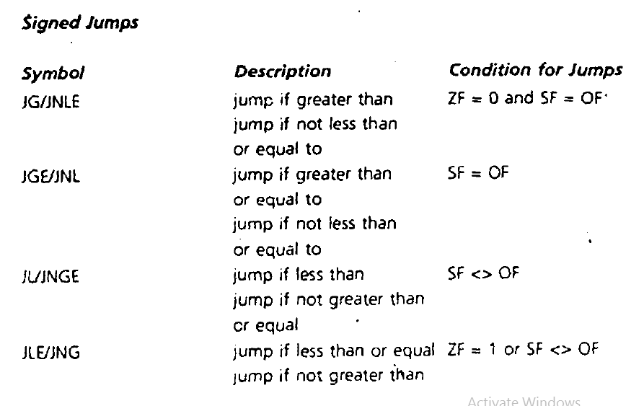
Conditional Jumps -Signed Jumps

Slide 3
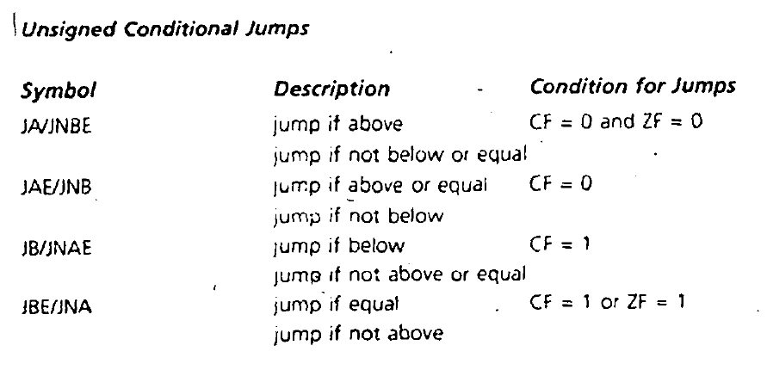
-Unsigned Jump

Slide 4
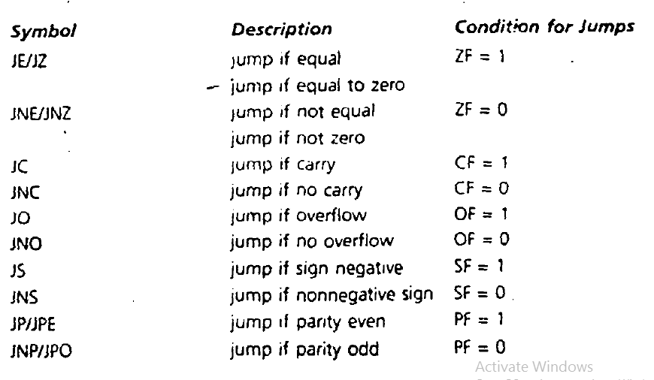
-Single-Flag Jumps

Slide 5
Example of Jump
MOV CX, 256
MOV DL, 0
MOV AH, 2
PRINT_LOOP:
INT 21H
INC DL
DEC CX
JNZ PRINT_LOOP
Also an example of a simple loop !

Slide 6
Conditional Jumps
JNZ destination_label
Range 126 bytes ! How do you overcome that?
Introduce another unconditional jump !

Slide 7
The CMP Instruction
CMP destination, source
CMP AX,BX ; (AX-BX) sets flags result wise
JG BELOW

Slide 8
Signed Versus Unsigned Jumps
If AX = 7FFFh (0111111111111111),
BX = 8001h (1000000000000001)
CMP AX,BX
JG BELOW ; Interprets in Signed Manner
CMP AX,BX
JA BELOW ; Interprets in Unsigned Manner

Slide 9
Working with Characters
- In working with the standard ASCII character set, either signed or unsigned jumps may be used, because the sign bit of a byte containing a character code is always zero. However, unsigned jumps should be used when comparing extended ASCII chars (code 80h to FFh).

Slide 10
What happens here?
MOV CX, AX
CMP BX, CX
JLE NEXT
MOV CX, BX
NEXT :
Bigger value is initiated in CX !

Slide 11
The JMP Instruction
-JMP destination
-JMP can be used to get around the range restriction of a conditional jump. For example, suppose we want to implement the following loop:
TOP:
;body of the loop
DEC CX
JNZ TOP
MOV AX,BX ; next instruction
and the loop body contains so many instructions that label TOP is out of range for JNZ (more than 126 bytes before JMP TOP). We can do this:
TOP :
; body of the loop
DEC CX ; decrement counter
JNZ BOTTOM ; keep looping if ex > 0
JMP EXIT
BOTTOM :
JMP TOP
EXIT :
MOV AX,BX ; next instruction

Slide 12
Branching Structures -IF-THEN
IF AX < 0
THEN
replace AX by -AX
END_IF
CMP AX, 0
JNL END_IFF
NEG AX
END_IFF :
IF condition is TRUE
THEN
execute true-branch statements
END_IF

Slide 13
IF-THEN-ELSE
IF AL <= BL
THEN
display the character in AL
ELSE
display the character in BL
END_IF
MOV AH, 2
CMP AL,BL
JNBE ELSE_
MOV DL,AL
JMP DISPLAY
ELSE_ :
MOV DL,BL
DISPLAY :
INT 21h
IF condition is true
THEN
execute true-branch statements
ELSE
execute false-branch statements
END_IF

Slide 14
SWITCH-CASE
CASE AX
<0: put -1 in BX
=0: put o in BX
>0: put l in BX
END_CASE
CMP AX,0
JL NEGATIVE
JE ZERO
JG POSITIVE
NEGATIVE:
MOV BX, -1
JMP END_CASE
ZERO:
MOV BX, 0
JMP END_CASE
POSITIVE:
MOV BX, 1
END_CASE:
MOV AH, 4Ch
INT 21H
CASE expression
Values_1: statements_1
values_2: statemeents_2
.
.
.
values_n: statements_n
END_CASE

Slide 15
Branches with Compound Conditions -AND Conditions
Read a character (into AL)
IF ('A' => character) and
(character <= 'Z')
THEN
display character
END IF
; read a character
MOV AH, 1
INT 21H
CMP AL, 'A'
JNGE END_IF
CMP AL, 'Z'
JNLE END_IF
MOV DL, AL
MOV AH, 2
INT 21H
END_IF :
; YOUR CODE IF CONDITIONS DIDNT MEET

Slide 16
Branches with Compound Conditions -AND Conditions
DIY
CLASS ASSIGNMENT COMING UP !

Slide 17
Looping Structure -FOR LOOP
The LOOP instruction can be used to implement a FOR loop. It has the form
LOOP destination_label
The counter for the loop is the register CX which is initialized to loop_count.
Execution of the LOOP Instruction causes CX to be decremented automatically.
if CX is not 0, control transfers to destination_label. If CX==0, the next instruction after LOOP is done. destinatlon_label must precede the LOOP instruction by no more than 126 bytes.

Slide 18
Continued…
MOV CX, 80d
MOV AH, 2
MOV DL, '*'
TOP:
INT 21h
LOOP TOP
MOV AH, 4Ch ; WHEN CX==0, THIS LINE GETS THE CONTROL AUTOMATICALLY
INT 21H
; Prints * 80 times !

Slide 19
Continued…
If CX contains 0 when the loop is entered, the LOOP instruction causes CX to be decremented to FFFFh.
The loop is then executed FFFFh = 65535 more times! To prevent this, the instruction JCXZ (jump if CX is zero) MAY BE used before the loop.
JCXZ destination_label
JCXZ SKIP
TOP:
;body of the loop
LOOP TOP
SKIP:

Slide 20
-WHILE LOOP
; counting number of chars in a line
MOV DX,0 ; DX counts characters
MOV AH,1 ; prepare to read
INT 21H
WHILE_:
CMP AL, 0DH ; CR?
JE END_WHILE ; yes, exit
INC DX ; not CR, increment count
INT 21H ; read a character
JMP WHIILE_
END_WHILE:
MOV AH, 4CH
INT 21H
Lets See an example of it !

Slide 21
-REPEAT LOOP
REPEAT
statements
UNTIL condition
; executes at least once, Do While loop !
MOV AH, 1
REPEAT: INT 21H
CMP AL,'A'
JNE REPEAT ; keeps reading until an A is found as input

Slide 22
WHILE Versus REPEAP
In many situations where a conditional loop is needed, use of a WHILE loop or a REPEAT loop is a matter of personal preference.
Advantage of a WHILE is that the loop can be bypassed if the terminating condition is initially false, whereas the statements in a REPEAT must be done at least once.
Code for a REPEAT loop is likely to be a little shorter because there is only a conditional jump at the end, but a WHILE loop has two jumps, a conditional JMP at the top and a JMP at the bottom.

Slide 23
Thanks !
Any questions ??
“NO”
OKAY LETS GET TO THE BUSINESS NOW, LETS SOLVE A PROBLEM !!
☺

Slide 24
ODD : Using proper prompts and indentation, take any integer value as input. If the number is either less than
4 or greater than 6, output “OUT OF RANGE !”.
Otherwise Output “IN RANGE !”
EVEN : Using proper prompts and indentation, take any capital letter character as input. If the character is A or E or I or O or U, output “VOWEL !”. Otherwise Output “CONSONANT !”
30 minutes, starts from right now. Turn off the monitor power button when time-end is declared.

